Slide 1
SOLID + DI + IoC
Advanced Unity

Slide 2
Content
SOLID.
SRP : Single Responsibility Principle
OCP : Open/Closed Principle
LSP : Liskov Substitution Principle
ISP : Interface Segregation Principle
DIP : Dependency Inversion Principle
IoC : Inversion of Control.
DI : Dependency Injection

Slide 3
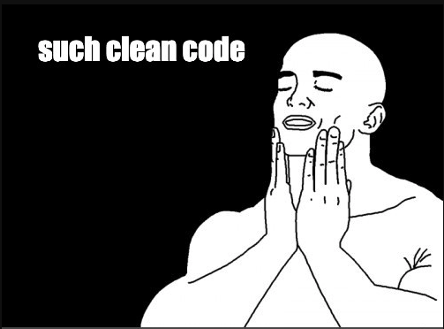
SOLID
It represents five basic principles of object-oriented programming and design.
It makes a system that is easy to maintain and expand over time.
Makes code more readable and extensive, reducing future refactorings.

Slide 4
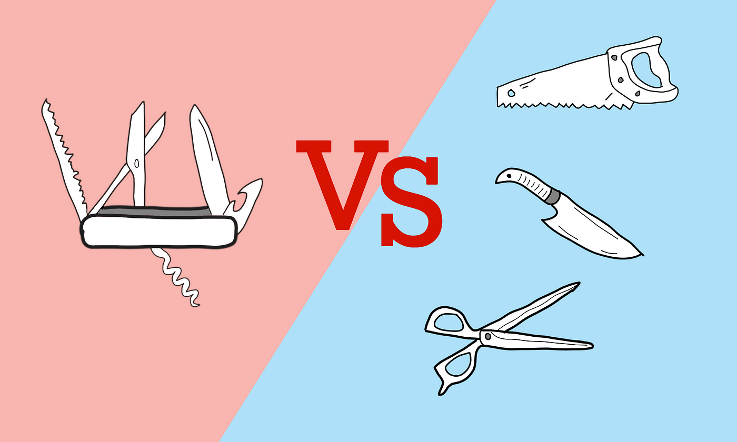
SRP: Single Responsibility Principle
Each class should have only 1 responsibility and 1 reason for change.
Facilitates:
Smaller, more readable classes.
Less coupled functionality.
Reusability of functionality.
Reduces:
Collateral damage when modifying code.

Slide 5
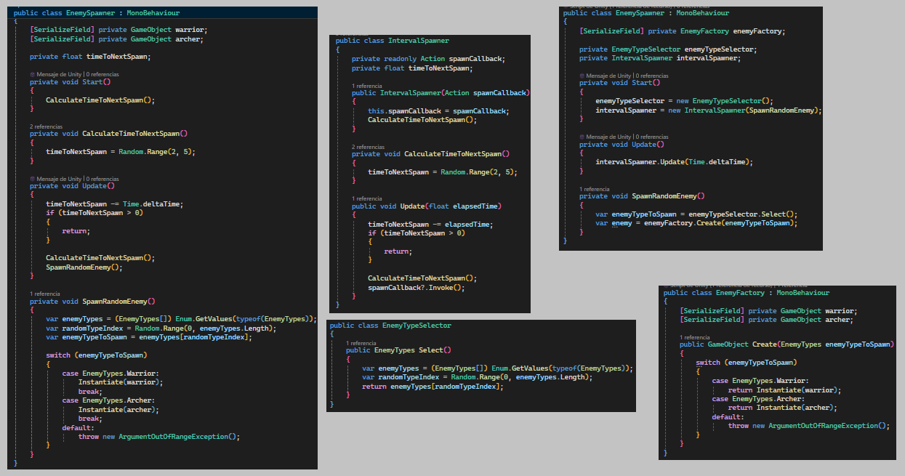
SRP: Single Responsibility Principle

Slide 6
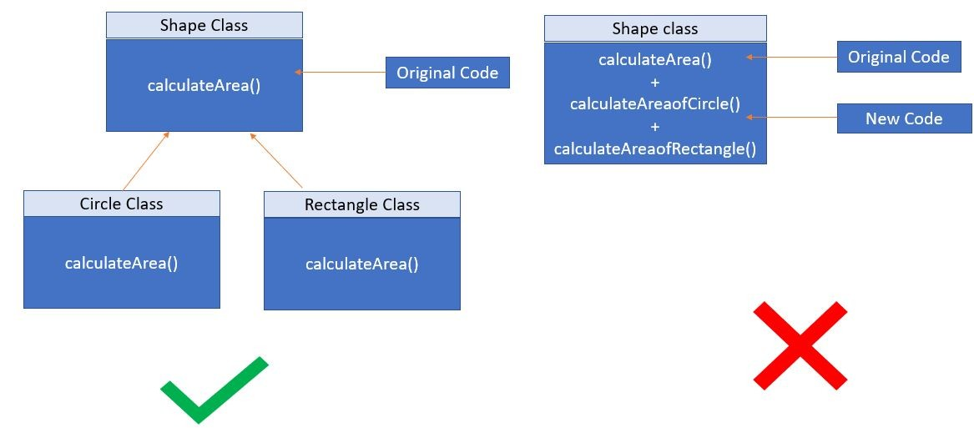
OCP : Open/Closed Principle
Open to extension: The system can grow without modifying existing code.
Closed to modification: The base class remains unchanged.
Facilitates:
Expansion without affecting the current system.
Reduces:
Switch and huge enumerations.
Cascading changes when adding functionality.

Slide 7
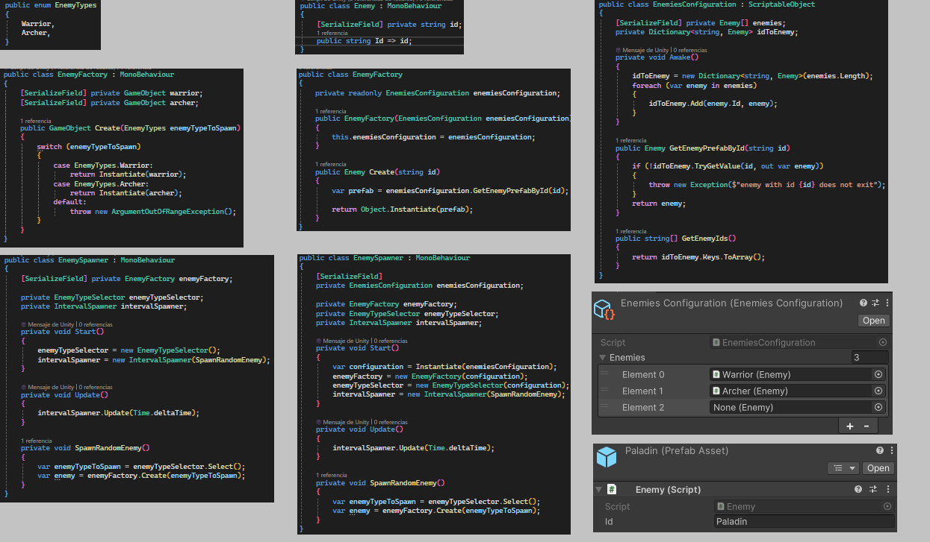
OCP : Open/Closed Principle

Slide 8
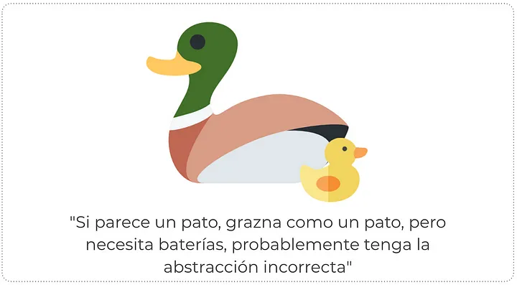
LSP : Liskov Substitution Principle
Facilitates:
Objects can be replaced by instances of their subclasses without causing the program to crash.
Reduces:
Avoid silent errors, where the program does not stop but works incorrectly.
Considerations:
Ask yourself whether inheritance is the best option or whether composition would be more appropriate.

Slide 9
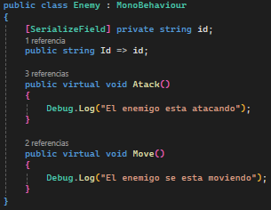
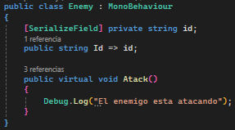

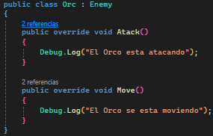
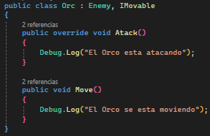
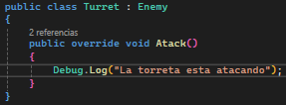
LSP : Liskov Substitution Principle

Slide 10
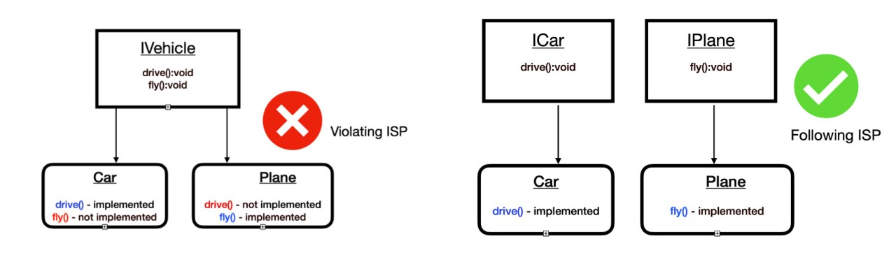
ISP : Interface Segregation Principle
Many specific client interfaces are better than one general purpose interface.
Clients should not be forced to depend upon interfaces that they don’t use.
Facilitates:
Clear interfaces for each consumer.
Reduces:
Reliance on unnecessary methods.
Errors when using functionalities that do not correspond.

Slide 11
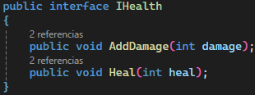


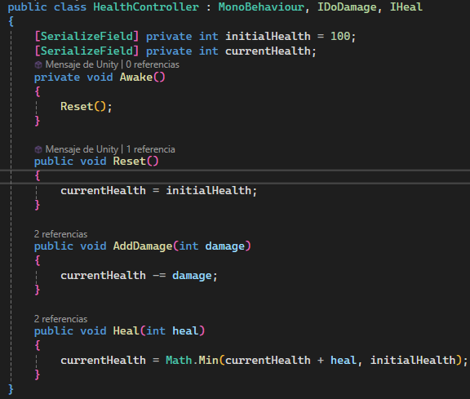
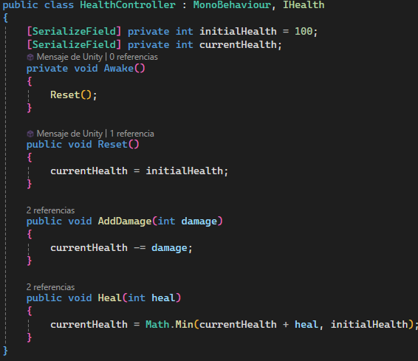
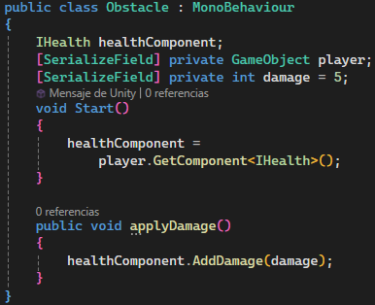
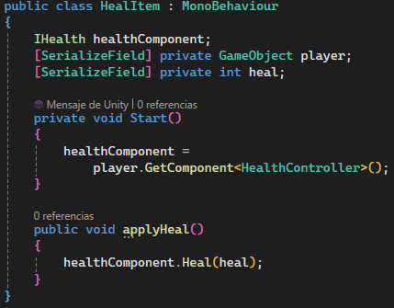
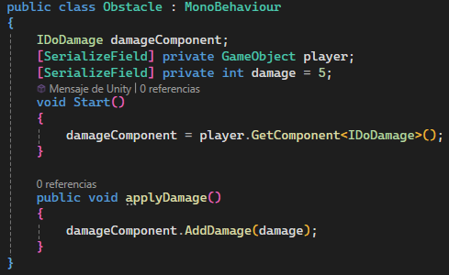
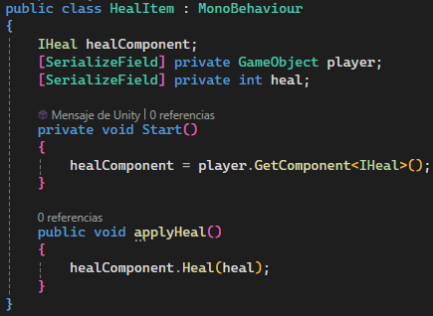
ISP : Interface Segregation Principle

Slide 12
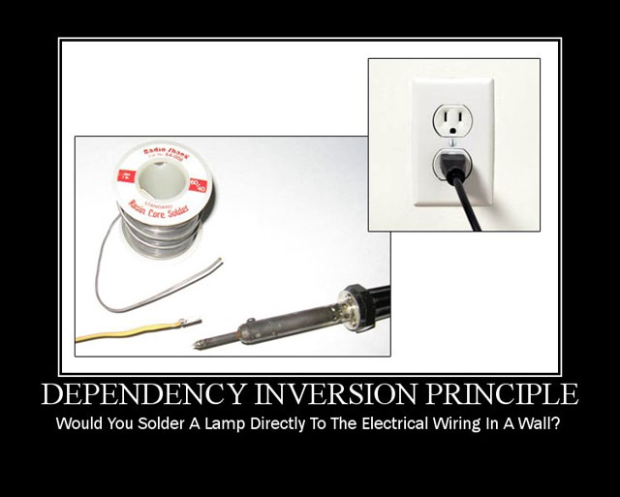
DIP : Dependency Inversion Principle
Proposes using abstractions (interfaces, abstract classes) instead of concrete details.
Facilitates:
Changes and new behaviors without modifying the consumer.
Division of labor between programmers.
More testable classes with mocks.
Reduces:
Dependence on specific details.
Coupling between modules.

Slide 13
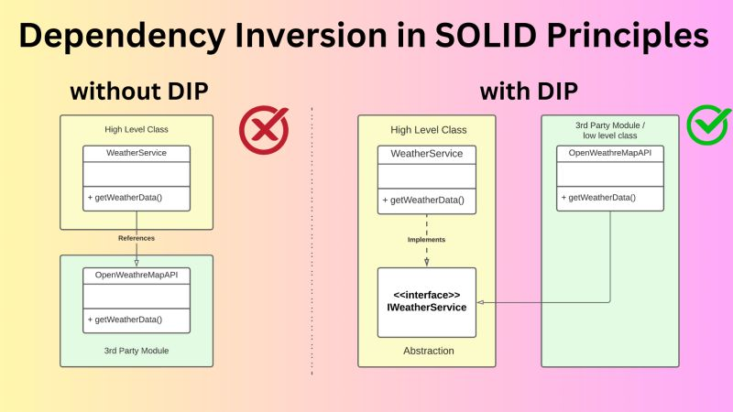
DIP : Dependency Inversion Principle

Slide 14
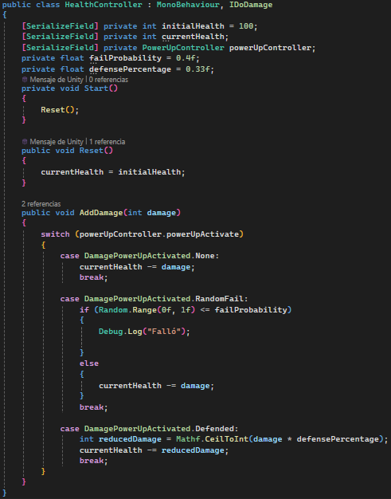
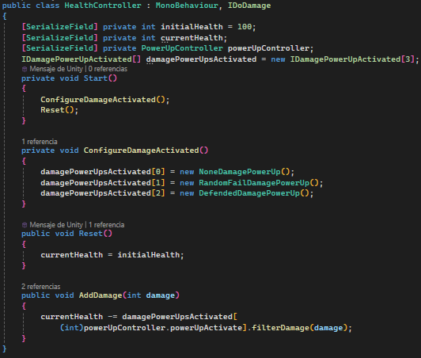

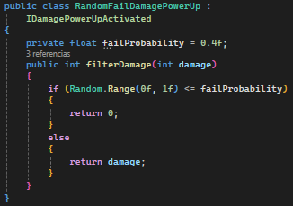
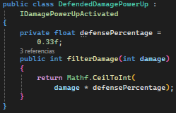
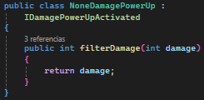
DIP : Dependency Inversion Principle
Here we must inject the dependencies.

Slide 15
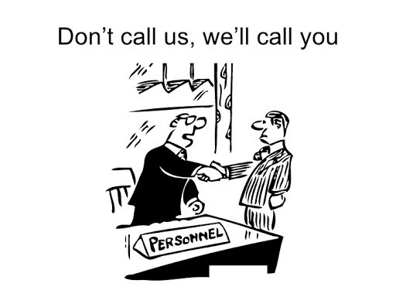
IoC : Inversion of Control
“Don't call us, we'll call you.”
Delegate the logic to another subsystem.
Instead of calling a library, the library invokes the client code.

Slide 16
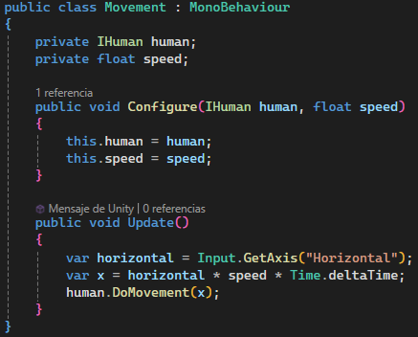
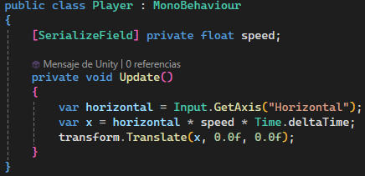
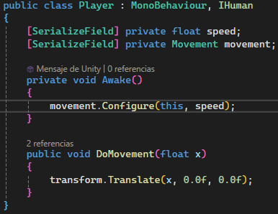
IoC : Inversion of Control

Slide 17
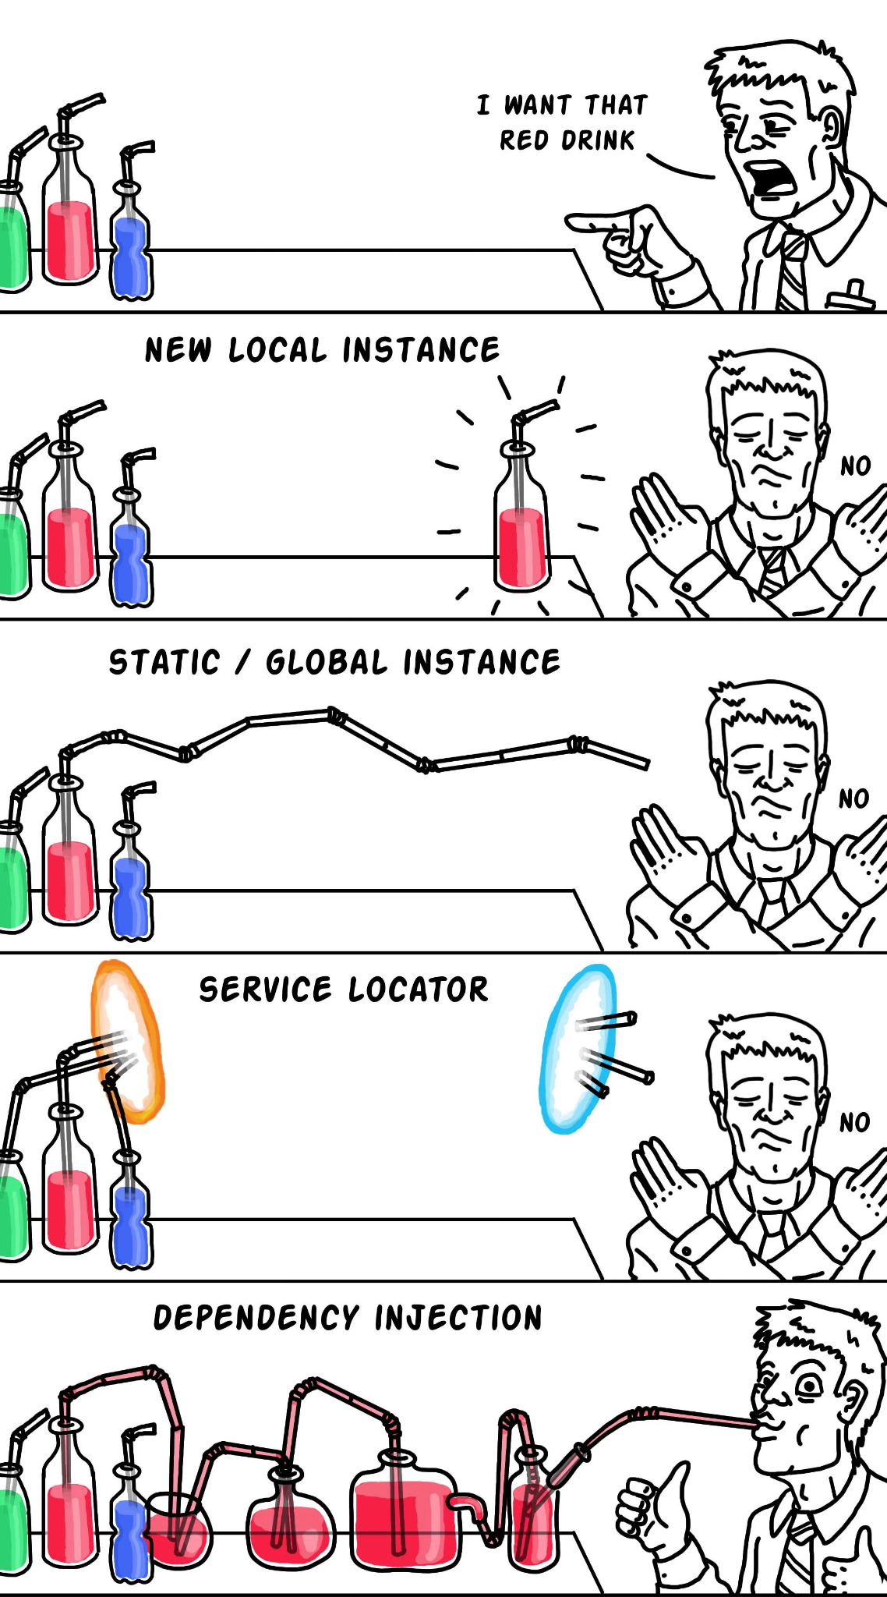
DI - Dependency Injection
IoC Frameworks
Passing dependencies through the constructor or through a configuration function.
That way everybody knows what dependencies they have from the rest of the system.

Slide 18
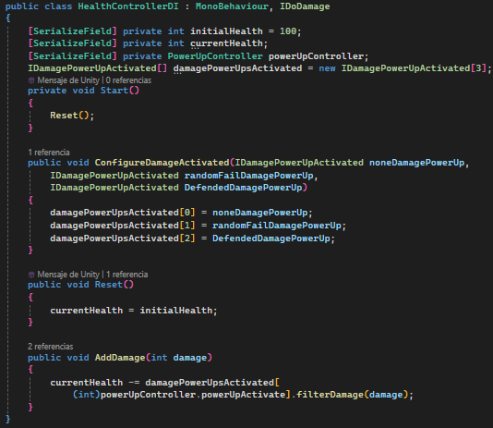
DI - Dependency Injection

Slide 19
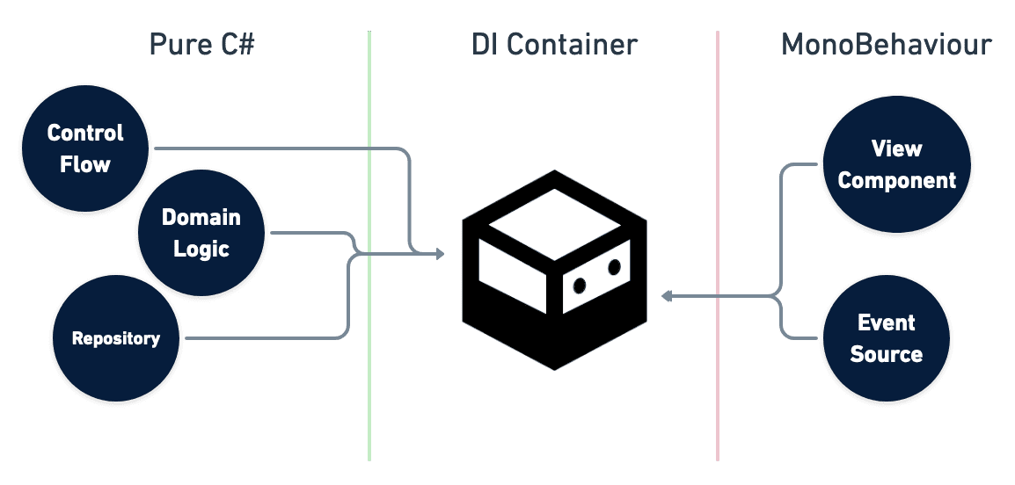
DI - Dependency Injection + Unity
There are many frameworks to achieve DI in Unity:
Unity Editor Itself (Direct References)
Good for Open/Closed principle
Bad for Single Responsibility Principle
Mono-Dependant issues (lifecycle, can’t test, can’t bind interfaces…)
Zenject/Extenject
My favorite DI framework choice
Not easy for beginners
VContainer
Never used myself
On the benchmarks looks better than Zenject
Do not have so many functionalities as Zenject

